Slide 1
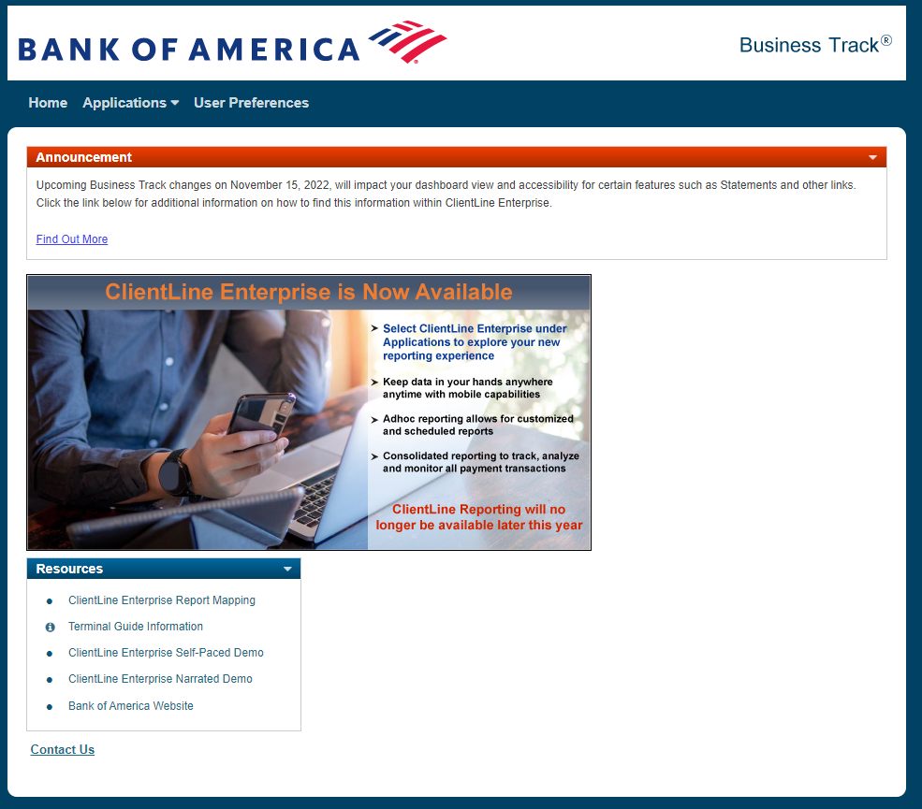
There are demos and also
A Report mapping guide on
This landing page

Slide 2
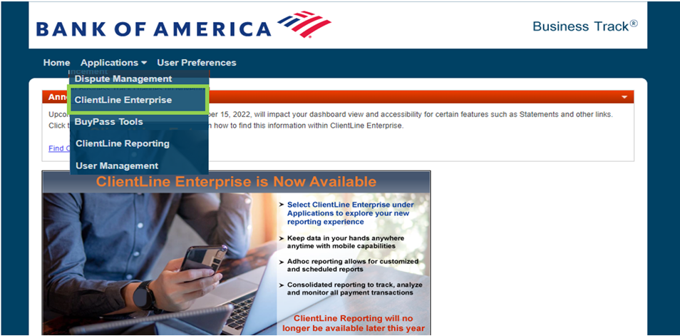
ClientLine Enterprise (CLX) can be chosen in the drop down menu
All current users should already have access

Slide 3
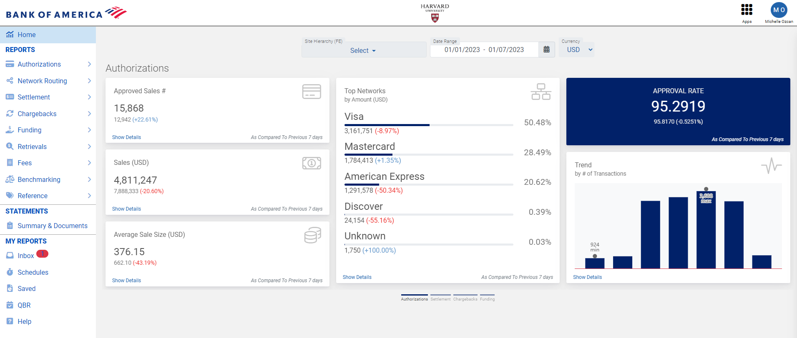


This is the Dashboard view.
Statements can be accessed on the left hand side

Slide 4
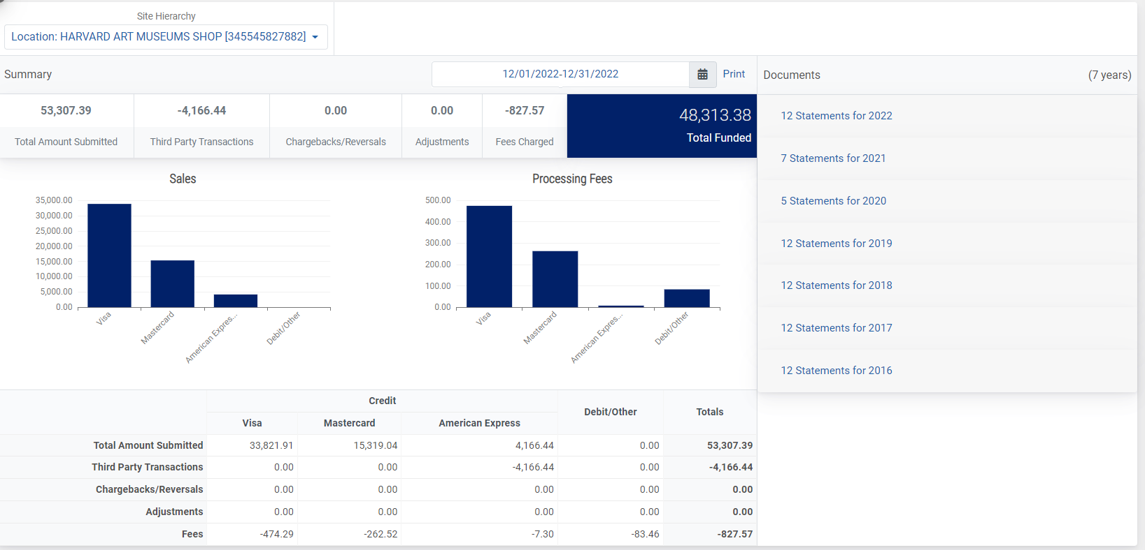



Monthly statements can be pulled at the outlet/MID level here. Enter the MID at the top
And the available statements appear on the right hand side.

